Slide 1
AQA Pre-Employment
2022 – Week2

Slide 2
DOCUMENT METADATA
DOCUMENT ID | 1111
TEMPLATE ID | AQA Pre-Employments 2022
CLASSIFICATION | PUBLIC/INTERNAL [4CH-INT] / CONFIDENTIAL [4CH-CNF] / RESTRICTED [4CH-RST] (most restricted access). Default: INTERNAL [4CH-INT]
REVISION NO. | 1.0
LAST MODIFIED | 20-10-2022
INFORMATION OWNER | Gyorfi Istvan / Andrei Enea
EMAIL
AUDIENCE
Revision History
REVISION | DATE | AUTHOR | REVISED BY | APPROVED BY | STATUS | DESCRIPTION OF CHANGE
1.0 | 20-10-2022 | Gyorfi Istvan | Reviser’s Name & Role | Approver’s Name & Role | Draft

Slide 3
What is JAVA?
https://www.java.com/en/download/help/whatis_java.html

Slide 4

Why use Java?

Slide 5
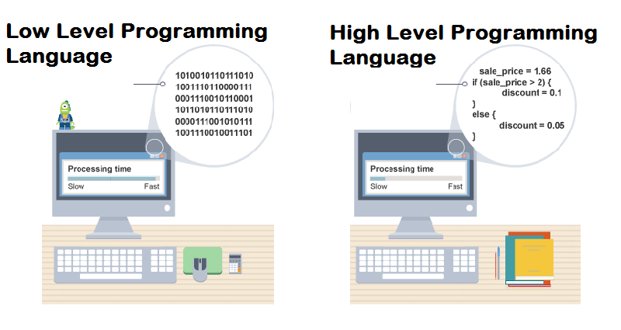
Why use Java?

Slide 6
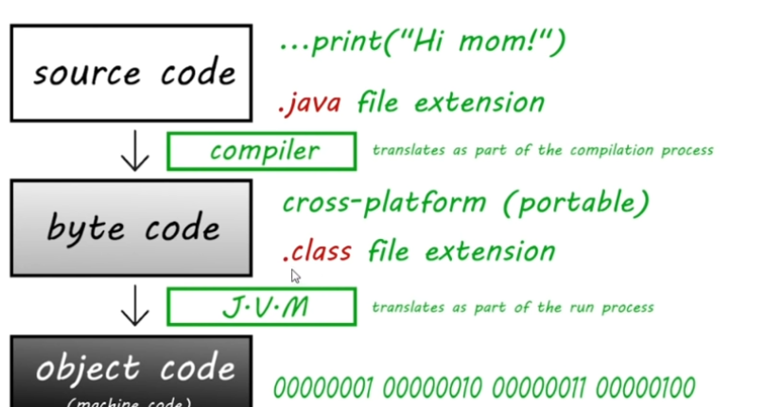
Why use Java?

Slide 7
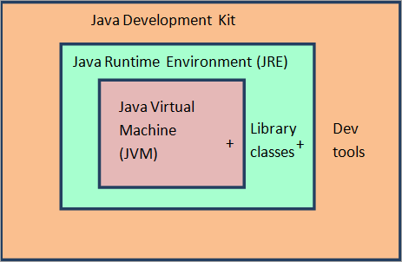
JDK?

Slide 8
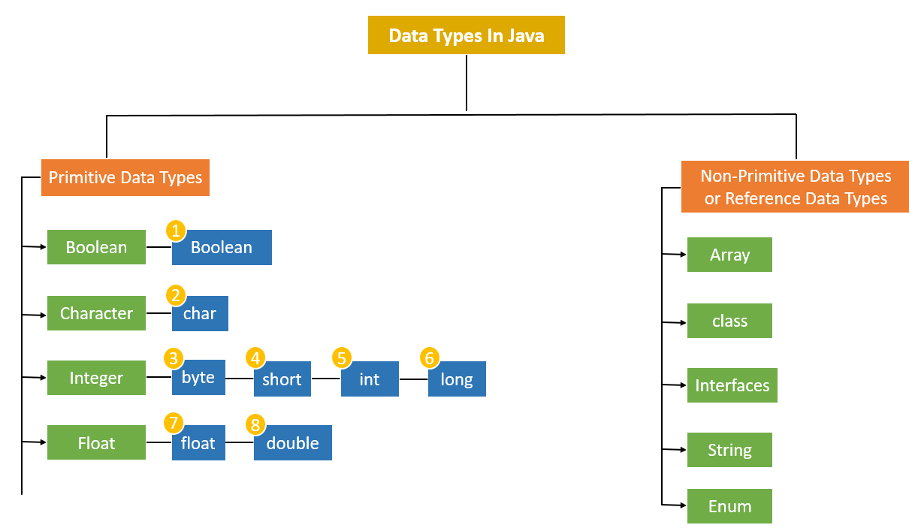
Variables

